Slide 1
Machine Learning Capstone Project
By Joseph Kuchar

Slide 2
Introduction
This project involves using the machine learning techniques we’ve learned in this course and applying them to dating profile data courtesy of OKCupid.
This data is composed of answers to a multiple-choice questionnaire, as well as 9 essay questions.
First we’ll look at a few features of the data, before trying to answer some questions using first regression techniques, and then classification techniques.

Slide 3
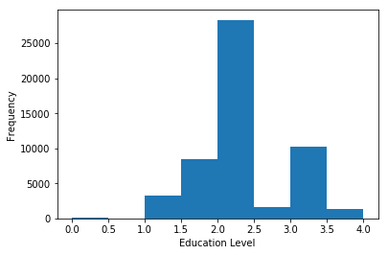
A Few Figures: 1. Education Level
Because the ‘Education’ feature of the data is composed of multiple choice answers such as “graduated High School”, or “dropped out of college”, it was necessary to transform these answers to a numeric scale if we’re going to do any analysis with it. I therefore created the “education level” column in the dataframe, where I transformed the text responses to numbers where High School is represented as a 1, college or University as a 2, a Masters as a 3, and a PhD as a 4 (and the half steps are used for non-completion, or for law or medical degrees which are technically bachelors but would likely lead to higher income). This figure shows most respondents have some amount of college or university education.

Slide 4
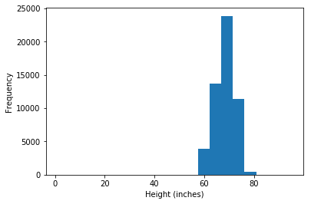
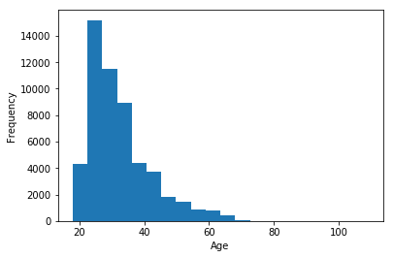
A Few Figures: 2. Age, and 3. Height
On the left, we have a histogram showing the age of the respondents. They are mainly in their twenties and thirties, but the tail reaches to around 70. I was curious about the height distribution (above), because I have frequently seen online that short men find online dating difficult. The smallest sizeable bin at around 60 inches (5 feet) would be considered short for a man, but I’ll note this is the full histogram and so includes both men and women.

Slide 5
Question #1: Do Short Men Put More Effort Into their Dating Profiles?
The idea here is that if it’s true that it’s harder for short men on online dating platforms, then you might expect them to compensate by putting more than the average amount of effort into their dating profiles.
Here I measure ‘effort’ by the amount of text in the combined essay questions.
We’ll try to use regression to model total essay length as a function of height, for men in particular.

Slide 6
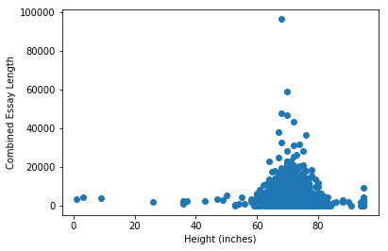
Question 1
This shows combined essay length versus height for all men in the dataset. It doesn’t look good for my hypothesis, certainly it doesn’t look like there’s a linear trend here. But we’ll try all the same.
Because it’s also possible that education level would correlate with the combined essay length, I decided to incorporate both height and education level into the regression fits.

Slide 7
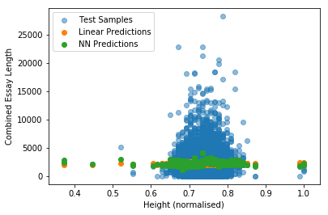
Question 1
Here I have used train_test_split to split the data into training and testing sets, and we show just the testing set and the corresponding predictions (with the fits determined from the training sets). The height and education level have been normalised prior to using sklearn to do the linear and near neighbour fits. I think this demonstrates pretty conclusively that there is no relationship between height and essay length (which we’re using as a proxy for dating profile effort). The R^2 score for the linear fit is 0.003, while for the nearest neighbor it is -0.003 at n=96, which was the minimum value of k from 1 to 100. Before we give up on this completely, there’s one more thing I wanted to try. One issue with this approach is that most respondents are average height, and this might cause that population to dominate the response.

Slide 8
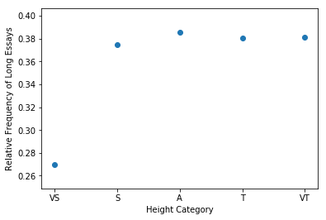
Question 1
To deal with the relative size of the average and tall versus short population, I created two new columns in the dataframe, which are “height code” and “verbose”.
The idea was to group people into height categories of very short (<5’), short (<5’8), going on to average, tall, and very tall (which we write as VS, S, A, T, and VT in the Figure, but are numeric codes 0 to 4 in the dataframe). The “verbose” column contains 0s and 1s, where 0 means the amount of text in the essays is less than the average, and 1 is more than the average. What this lets us do is count how many men in each category have relatively long essays, and by dividing by the total number of men in each category, we get the relative number for each population. To get these numbers, I used the crosstab function in pandas:
verbose 0 1
height_code
0 32 13
1 4904 2994
2 10222 6359
3 4069 2518
4 294 183
What this demonstrates is (not counting the VS category, which is a small population) that the relative frequency of long essays (again, a proxy for effort) is actually fairly constant!

Slide 9
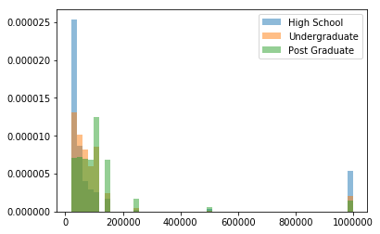
Question 2: Can we predict income with age and education level?
Here I’ve created a normalised histogram showing relative populations with their incomes. It was necessary first to remove all entries with -1 as a reported income (which was the majority). I made this by constructing three data frames, using the loc function and the education level (EL) column I defined previously. This isn’t the whole population, High School has EL=1, Undergraduate has EL=2, and Post Graduate has EL>=2.5 (to include medical, law, masters, PhD, etc).
This shows that, for incomes less than a few hundred thousand a year, education level scales reasonably with income. At a million dollars this is no longer true, but I would doubt the veracity of people claiming they’re millionaires on OKCupid anyway.

Slide 10
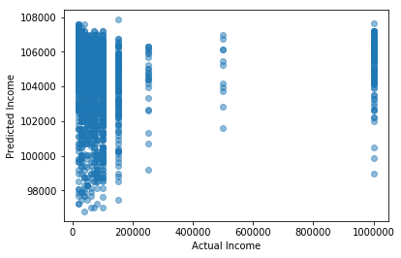
Question 2
This shows the result of multilinear regression on age and education level to predict income, and it’s not promising. We’re looking at predicted income versus actual income, and the scatter is enormous. The R^2 score of this was 0.00016, which is essentially 0. Once again, we’ll try the nearest neighbors regression and see if that works any better. I also tried adding the essay_len column to the regression, and this decreased the score to 8E-5, still essentially 0. I then added sex to the regression, by creating the column sex_code with 1 for men and 2 for women (one X vs 2X). This slightly improved the score to 0.0046. My suspicion is that the large number of respondents claiming a million dollar income is the issue, so I’ll try removing those.

Slide 11
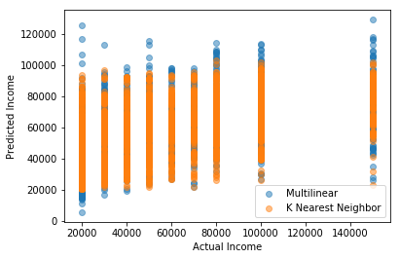
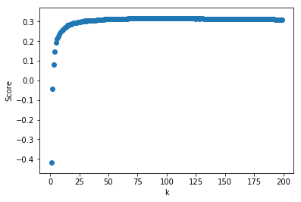
Question 2
In fact, we can improve the ability to predict income if we limit ourselves to ‘reasonable’ incomes.
When incomes greater than 500K per year are removed, the multilinear fit score improves to 0.14
If we limit ourselves to less than 200K per year, then the multilinear fit score improves to 0.25 – a drastic improvement from the previous slide (but still nothing amazing).
The predicted vs actual income is displayed to the right.
I also tried K nearest neighbours, with K from 1 to 200, and the best score was achieved for K=88, with a score of 0.3178 (Score vs. K shown on bottom right).
The columns used to make this prediction are age, education level, sex, and essay length.
The data also include a job column, which could be used to improve the prediction, but it would involve a certain level of arbitrariness to assign numerical values to job types. If the number scale were based on assumed income, then it would be fairly circular!

Slide 12
Question 3: Classification! Can we predict sex with pets and jobs?
The simplest classification test seems to be to see if we can determine sex, since there are only two categories.
Since people spend so much of their lives at work, and those with pets spend so much of the rest with their pets, it seems like these are reasonable data types to use for our classification attempt.
The first step here is to see what the pet and job columns look like. There are 21 possible values in the job category, but I will remove ‘other’, ‘retired’, ‘unemployed’, and ‘rather not say’ responses so that we’re left with people who are employed. I’ll then try to create a numerical scale from 1 to 17 roughly corresponding to humanities to business to science, but it’s obviously pretty imprecise.
There are 15 possible responses in the pets category, for whether respondents own, like, or dislike, dogs, cats, or both. Here we can use negative values for dislike and positive values for like or own.

Slide 13
Question 3
The pet_code column was created by assigning numerical values to likes, dislikes, and haves, of cats and dogs:
PET | Like | Dislike | Have
Dog | +3 | -3 | +6
Cat | +2 | -2 | +4
Any value in the pets column is transformed to pet_code by addition of the table values. So for instance, someone who has a cat but dislikes dogs has a code of +4-3=-1.

Slide 14
Question 3
def job_code(x):
if x=='other':
return -1
elif x=='student':
return 8.
elif x=='science / tech / engineering':
return 16
elif x=='computer / hardware / software':
return 15
elif x=='artistic / musical / writer':
return 1.
elif x=='sales / marketing / biz dev':
return 2.
…
Transforming jobs into numerical values is much more arbitrary than pets, unfortunately.
My choice was to give a unique number to each response, with 1-7 being jobs that don’t necessarily require a lot of education (for instance, arts and music are 1, and transportation is 6), with 8 being student, and 9-16 being jobs that probably require more education (such as law at 11, political at 12, and medicine at 14).
The transformation is in the Q3_Classification.py code, in the job_code function, with a sample shown to the right.

Slide 15
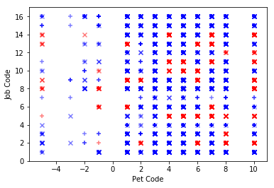
Question 3
In the figure to the right, we’re looking at the results of near neighbor classification (with n=2 for the two sexes) to determine sex from the transformed pet and job answers.
The actual sex is represented by the symbols, with + for men and x for women. The colours represent the predicted sex, with blue for men and red for women.
Therefore, a blue + or a red x is a correct prediction,
While a blue x or red + is a false prediction.
The accuracy score of this classification is 0.6156, which is not bad considering the extreme handwaviness with which we constructed the job categories.
Type | Score
Accuracy | 0.62
Precision | 0.63
Recall | 0.89
F1 Score | 0.73
The time it took to run the Near neighbour classifier was only 0.19 seconds, which we’ll see is incredibly speedy compared to the Support Vector method.

Slide 16
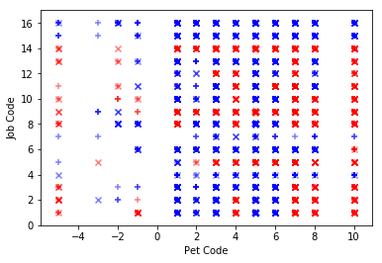
Question 3
Similarly to last slide, we are looking at the same figure and table, but constructed with the Support Vector classification method, with the radial basis function kernel.
As before, the actual sex is represented by the symbol, with + for men and x for women. The colours represent the predicted sex, with blue for men and red for women.
Therefore, a blue + or a red x is a correct prediction,
While a blue x or red + is a false prediction.
These predictions were made with default values of gamma and C. I tried varying them between 1 and 50, and didn’t significantly change the accuracy.
Type | Score
Accuracy | 0.67
Precision | 0.70
Recall | 0.80
F1 Score | 0.74
The time it took to run the SVC classifier was 23.4 seconds, which is a whopping 123 times longer than the NN classifier. In this case, it’s hard to say that’s worth the marginal increase in accuracy and F1 score.

Slide 17
Recap
In this presentation, we’ve tried to use regression to answer 2 questions: a) Do short men put more effort into dating profiles than men of average height? And b) Can we predict income given age and education level? We then used classification methods to determine whether we could predict whether someone is male or female depending on how they feel about pets and what they do for a job.
We saw no correlation at all in essay length versus height, and even when we normalised by number of responses in different height categories, we found no dependency on height. Therefore there is no evidence, that we’ve seen, that short men write longer essays than average height or tall men.
We used both linear and near neighbour regression to fit age and education level to income, with the near neighbor regression slightly outperforming the linear regression. In both cases, the accuracy only increases significantly above zero when very high income respondents are removed.
Finally, we used both near neighbor and SVC classification to determine whether we could predict sex with pets and jobs. The largest uncertainty here was in converting text responses to numbers, since those numbers are then used in the algorithms to compute distances. This informed my choice in how to number (so that, for instance, doctors and lawyers are numerically close to each other, as ‘high powered’ professions), but it’s an ad-hoc construction. We found that the SVC classifier slightly outperformed the near neighbor classifier, but at the cost of a significant increase in computing time.

Slide 18
Conclusion
There is no relationship between height and amount of text in essays in OKCupid dating profiles.
There is a relationship between income, age, and education level, but not as strong as you might think. This might be affected by the very large student population on OKCupid, which will have no or small incomes, as well as outliers (like the unbelievably large population who claimed to be millionaires).
I decided to re-do the regression above, but including the job_code column (since we had to make it for Q3 anyway) in the code Q2_Education_Income_revisited.py. When we try to predict income as a function of age, education level, essay length, sex, and job type, then the linear fit accuracy increases to 0.31 and near neighbor accuracy to 0.42 at k=28. Still less than I would expect!
The classification problem, of predicting sex based on pets and jobs, actually worked fairly well. I think it could probably be refined, perhaps by trying a different transformation to the jobs. Instead of numbering each entry separately, they could be grouped into a few broader categories. An issue with this data, though, is that by far the largest job segment was ‘student’, and this includes people with a lot of different career paths. Perhaps the fit could be improved if students were removed, but that would be a lot of data to discard.
Thank you to whoever reads this!

